Slide 1
Guide to MLA
(That stands for Modern Language Association)
Revised from Ms. Zebrowski

Slide 2
Format
Typed & printed on white 8.5x11 paper
Double space
12 pt. Times New Roman font
One space after punctuation
1 inch margins on all sides
Indent first line of all paragraphs (Tab key)
Header with last name & page number in top right corner

Slide 3
The First Page
In the upper left corner:
Your Name
Your Teacher’s Name
Name of the Class
Due Date
Centered in the middle:
Title of Your Paper

Slide 4
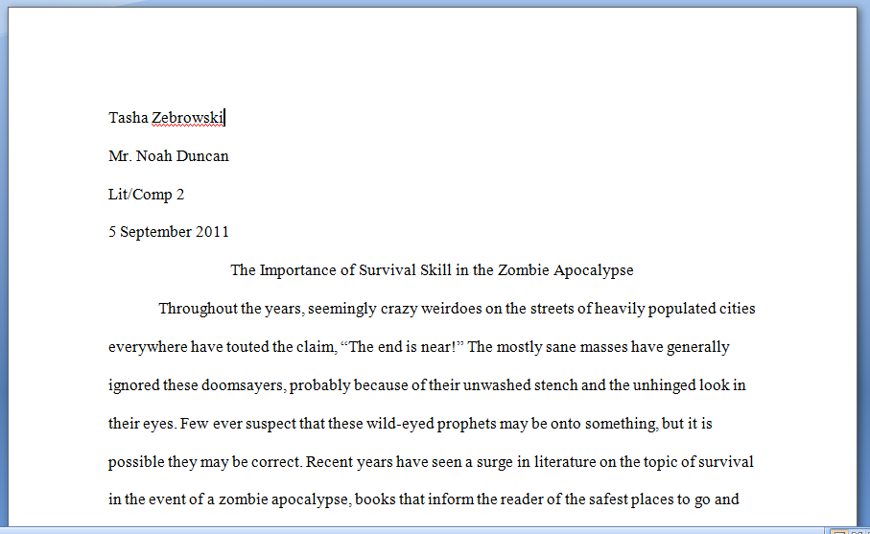
The First Page: Example
My Name
My Teacher’s Name
Course Name
Due Date
Paper Title

Slide 5
In-text Citations
Book with one author: last name and page number
Ex: "The sure way to put one down is to destroy its brain’’ (Castro 23).
OR
According to zombie expert Adam-Troy Castro, ‘’The sure way to put one down is to destroy its brain’’ (23).
OR
Destroying a zombie’s brain is the only sure way to put one down (Castro 23).

Slide 6
More In-Text Citations
Book with two authors: first last name and page number
Ex: ‘Two adult unmentionables busied themselves feasting upon the flesh of the household staff’ (Austen 80).
OR
Jane Austen and Seth Grahame-Smith describe this encounter: ‘Two adult unmentionables busied themselves feasting upon the flesh of the household staff’ (80).

Slide 7
Yet More In-text Citations
Website with an author: last name
Ex: ‘A major city is the absolute worst place to be in the event of a zombie uprising’ (Brockway).
OR
Internet columnist Robert Brockway states, ‘A major city is the absolute worst place to be in the event of a zombie uprising.’

Slide 8
Sick of In-text Citations? Too Bad!
Website with no author: choose the first keyword from the title
The following example is taken from a website called “Zombie Taxonomy”
Ex: “It could cause them to crave to eat human flesh and nothing else” (“Taxonomy”).
OR
The website “Zombie Taxonomy” warns, “It could cause them to crave to eat human flesh and nothing else.”

Slide 9
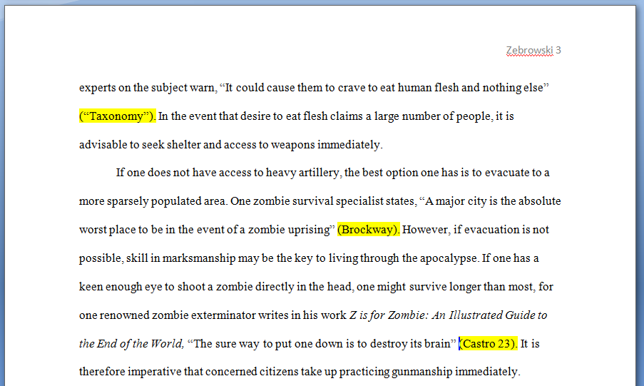
In-text Citations: Example

Slide 10
Introduction
Purpose
Engage the reader
Informs the reader of the topic
Tells the reader why they should be interested in the topic
Tips/Tricks
Last sentence should be the thesis statement

Slide 11
Works Cited Page: Layout
Centered at top of page: Works Cited
List all entries in alphabetical order
Double-space
Hanging indentation
All but first line is indented

Slide 12
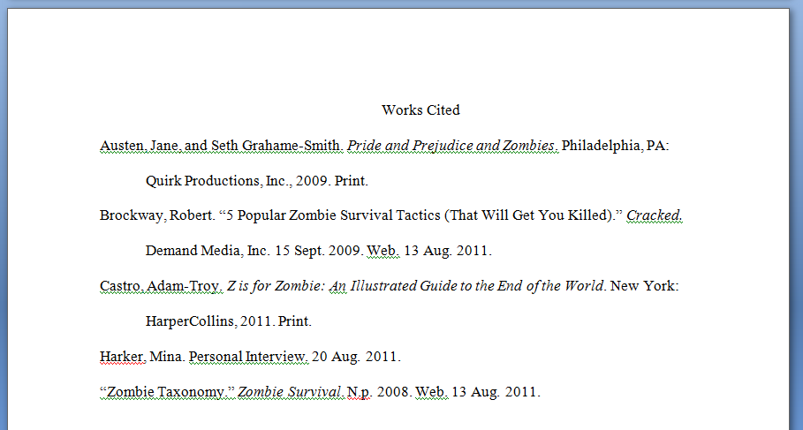
Works Cited Page: Example

